Slide 1
Network Security
Assignment 4
Herschelle Gupta 2019045
Ritik Vatsal 2019321

Slide 2
Project 0
Securely Time stamping a document.
Time stamping Server - GMT date time and adding a Digital Signature

Slide 3
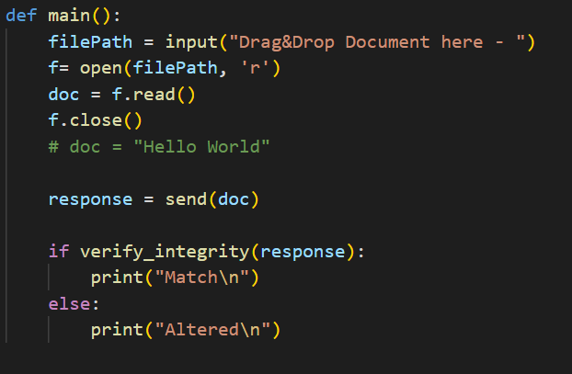
Input
In the client file, Input can be provided by dragging and dropping file (or directly in the doc field)

Slide 4
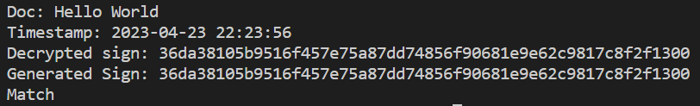
Output - Client
The Client shows the following parameters when it's run -
Doc Input Timestamp Timestamp received from the Server Decrypted Sign Signature received from the server Generated Sign Signature calculated from the file Match/Altered Result of comparing the above signatures.

Slide 5

Output - Server
The Client shows the following parameters when it's run -
Doc Receive Doc from Client Timestamp Current Timestamp Signature Generated Signature

Slide 6
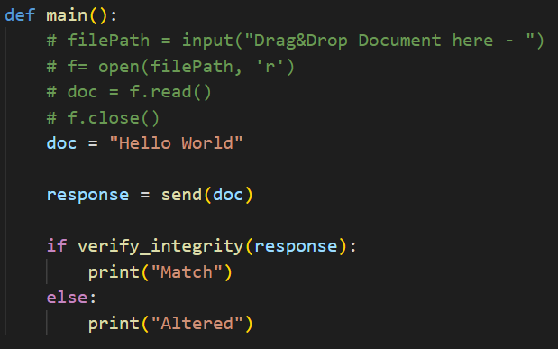
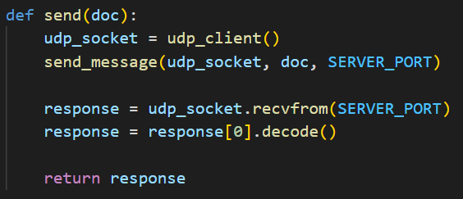
Working - Client
Inputs and Initialisation
Using UDP to send document to the server

Slide 7
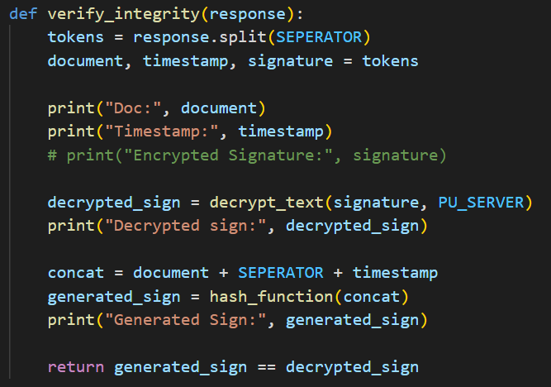
Working - Client
Verifying Integrity of messages by comparing the hash received from server with the current hash of the document

Slide 8
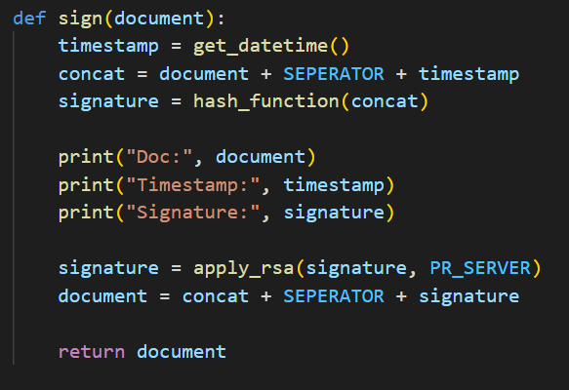
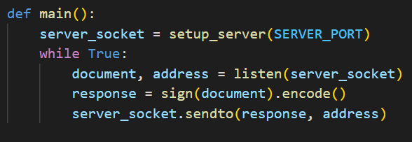
Working - Server
Starting UDP server and receiving document
Generating timestamps and using RSA for signature

Slide 9
Thank You!

